Slide 1
Predicting High school Graduation rates
Mark Orland

Slide 2
The data
ACGR (Adjusted Cohort Graduation Rates)
Tracks students who enter high school together and graduate on time
Accounts for transfers
Tract Data
Small subdivisions of a county
Found overlap with school district
Census
Notes:
ACGR was joined with the tract data based on the state/school district id
This was then joined with the census data based on state/county/tract

Slide 3
EDA/Trend Analysis
Notes:
Understanding what the features were
Started with a lasso regression to get an idea of the most important features
Results basically said that racial graduation rate is most correlated
Dropped it
From there I put it in a random forest and got more diversified results
Added finance and crime data
Form there I looked into correlations

Slide 4

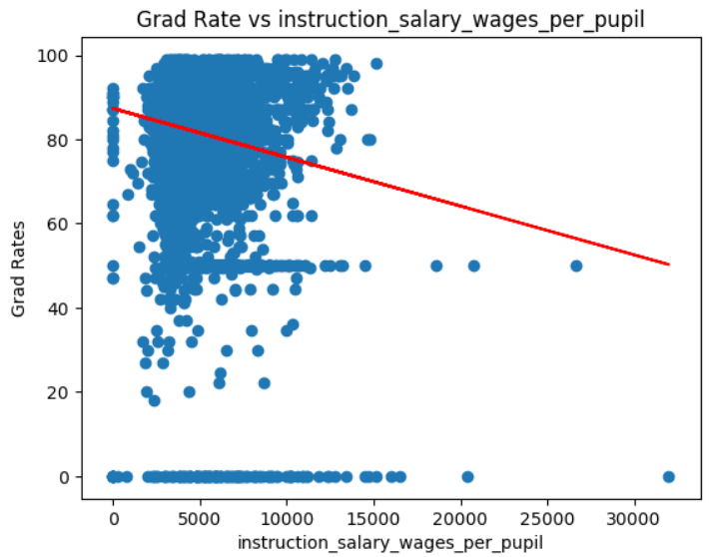
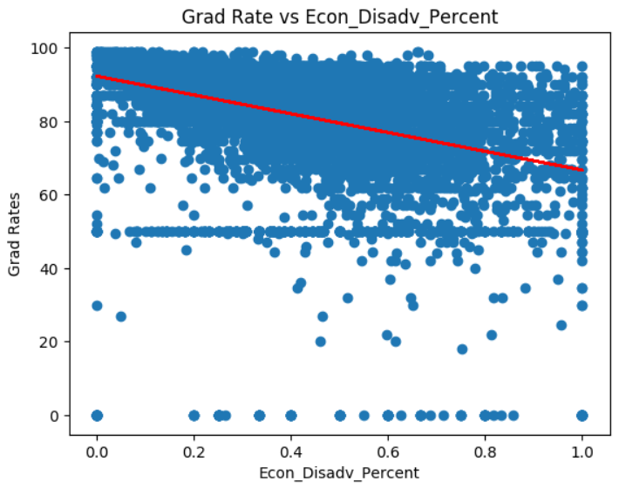

Slide 5
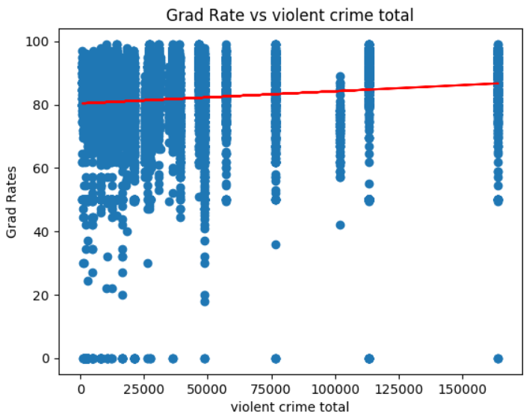
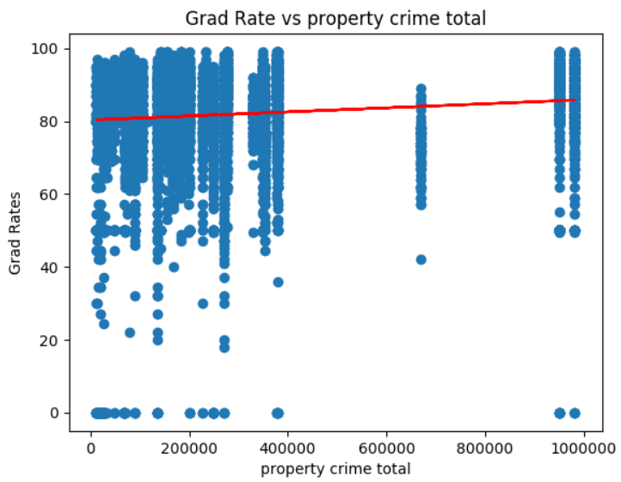

Slide 6
Predictions
Notes:
Used the parameters from the national model to create a model for each state and then predict changes to signifant features
Accuracy score is 43%

Slide 7
example
Current Rates
Grad Rate = 57%
Economically Disadvantaged = 84.4%
Wages/pupil = $3743
State Violent Crime Incidents = 164133
State Property Crime Incidents = 981939
Reduce Economically Disadvantaged by 70% to 14.7%
New Grad Rate is 93%

Slide 8
Thank you
Notes:
Would have liked to actually look into the features
For example mobile homes came up in the top 10 but that is most likely related to income

